Slide 1
GEMS Wellington Primary School Science Week 2013

Slide 2
Have you ever wondered?
At what temperature will ice cream give me brain freeze?
How long can a banana last?
Do animals like music?
How do you make the BEST paper airplane?
Can plants grow upside down?

Slide 3
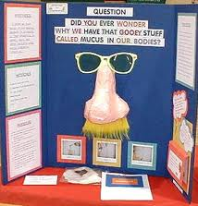
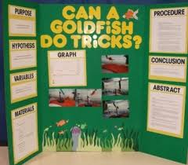
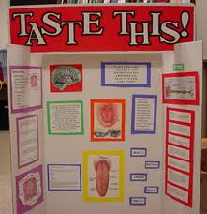
Science Fairs around the World…
This is your chance to find the answers to the craziest questions you can think of!

Slide 4
What do I need to do?
Think of an amazing idea or a question that you would like to know the answer to!
Plan and carry out an experiment at home to find the answer.
Make a poster to share your findings with your class. You could even bring in
props or parts of your
experiment to share.

Slide 5
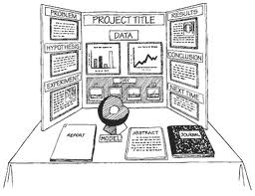
Things to think about…
Think like a scientist… is your investigation fair, is it repeatable?
Think like a designer… what will make people want to read and look at your project?

Slide 6
Things to think about…
You need to include all of the parts of an investigation:
the question
a hypothesis
how you carried out the investigation
the results, conclusion and evaluation
Bring your project to school on Sunday 12th May to share with the rest of your class.

Slide 7
Good Luck!
Each class will choose 3 projects to share with the rest of the school and the parents in the main hall.

